Slide 1
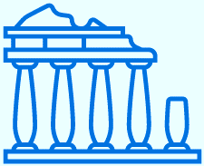
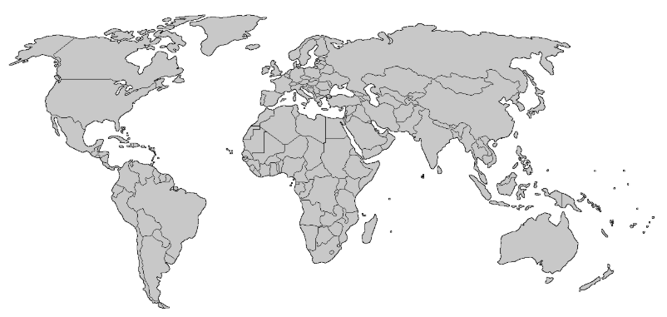
Year 4
HISTORICAL CONTEXT
THE ANCIENT GREEKS
Stone Age | Iron Age | Ancient Egyptians | Ancient Greece | Romans | Saxons | Vikings | Maya | World War II The Blitz | Civil Rights Movement
Stone Age | Iron Age | Ancient Egyptians | 1200 BC – 146 AD | Romans | Saxons | Vikings | Maya | World War II The Blitz | Civil Rights Movement
KEY VOCABULARY
KEY PEOPLE & PLACES
KEY EVENTS
1 | Acropolis | A fortified part of an ancient Greek city, typically built on a hill. The Parthenon is built within the acropolis at Athens.
2 | Bio | Greek word meaning ‘life’
3 | Democracy | ‘Ocracy’ means power and ‘demo’ means people. A democracy is where people have the power to vote and govern themselves.
4 | Geo | Greek word meaning Earth
5 | Graph | Greek word meaning ‘write’
6 | Kilo | Greek word meaning ‘one thousand’
7 | Mount Olympus | The highest mountain in Greece and believed to be the birthplace of the Olympian gods.
8 | Myth | From the Green word ‘mythos’ meaning speech.
9 | Oligarchy | ‘Oligos’ means few and ‘arch’ means to rule. An oligarchy is a type of government where the power is in the hands of only a few people
10 | Polytheistic | ‘Poly means many and ‘theos’ means god. The Ancient Greeks worshipped more than one god
1 | Achilles | Hero of the Trojan war.
2 | Heracles | The mortal son of Zeus and Greek her
3 | Midas | A king who turned things he touched to gold
4 | Zeus | King of the Gods on Mount Olympia
5 | Athena | Daughter of Zeus and goddess of wisdom and war
6 | Hermes | Son of Zeus and messenger of the gods
7 | Poseidon | God of the sea
8 | Apollo | God of knowledge and prophecy
9 | Nike | Goddess of victory
10 | Nemesis | Goddess of revenge
776 BC |  | The first Olympic games take place.
750 BC |  | The Greek poet Homer begins to write the Odyssey and the Iliad.
508 BC |  | Cleisthenes, introduces democracy to Greek laws.
490 BC |  | The Battle of Marathon where the Greeks defeated the Persians.
432 BC |  | The most famous building in Athens, the Parthenon, is completed.
432 BC |  | Pluto, the Greek philosopher and student of Socrates, creates the first institution of learning called The Academy.
386 BC |  | Alexander the Great becomes king and expands the Greek empire.
146 BC |  | The Romans defeat the Greeks at Corinth, making Greece part of the Roman Empire.
Key Concepts | Cultural |  | Economic |  | Military |  | Political |  | Religious |  | Social

