Slide 1

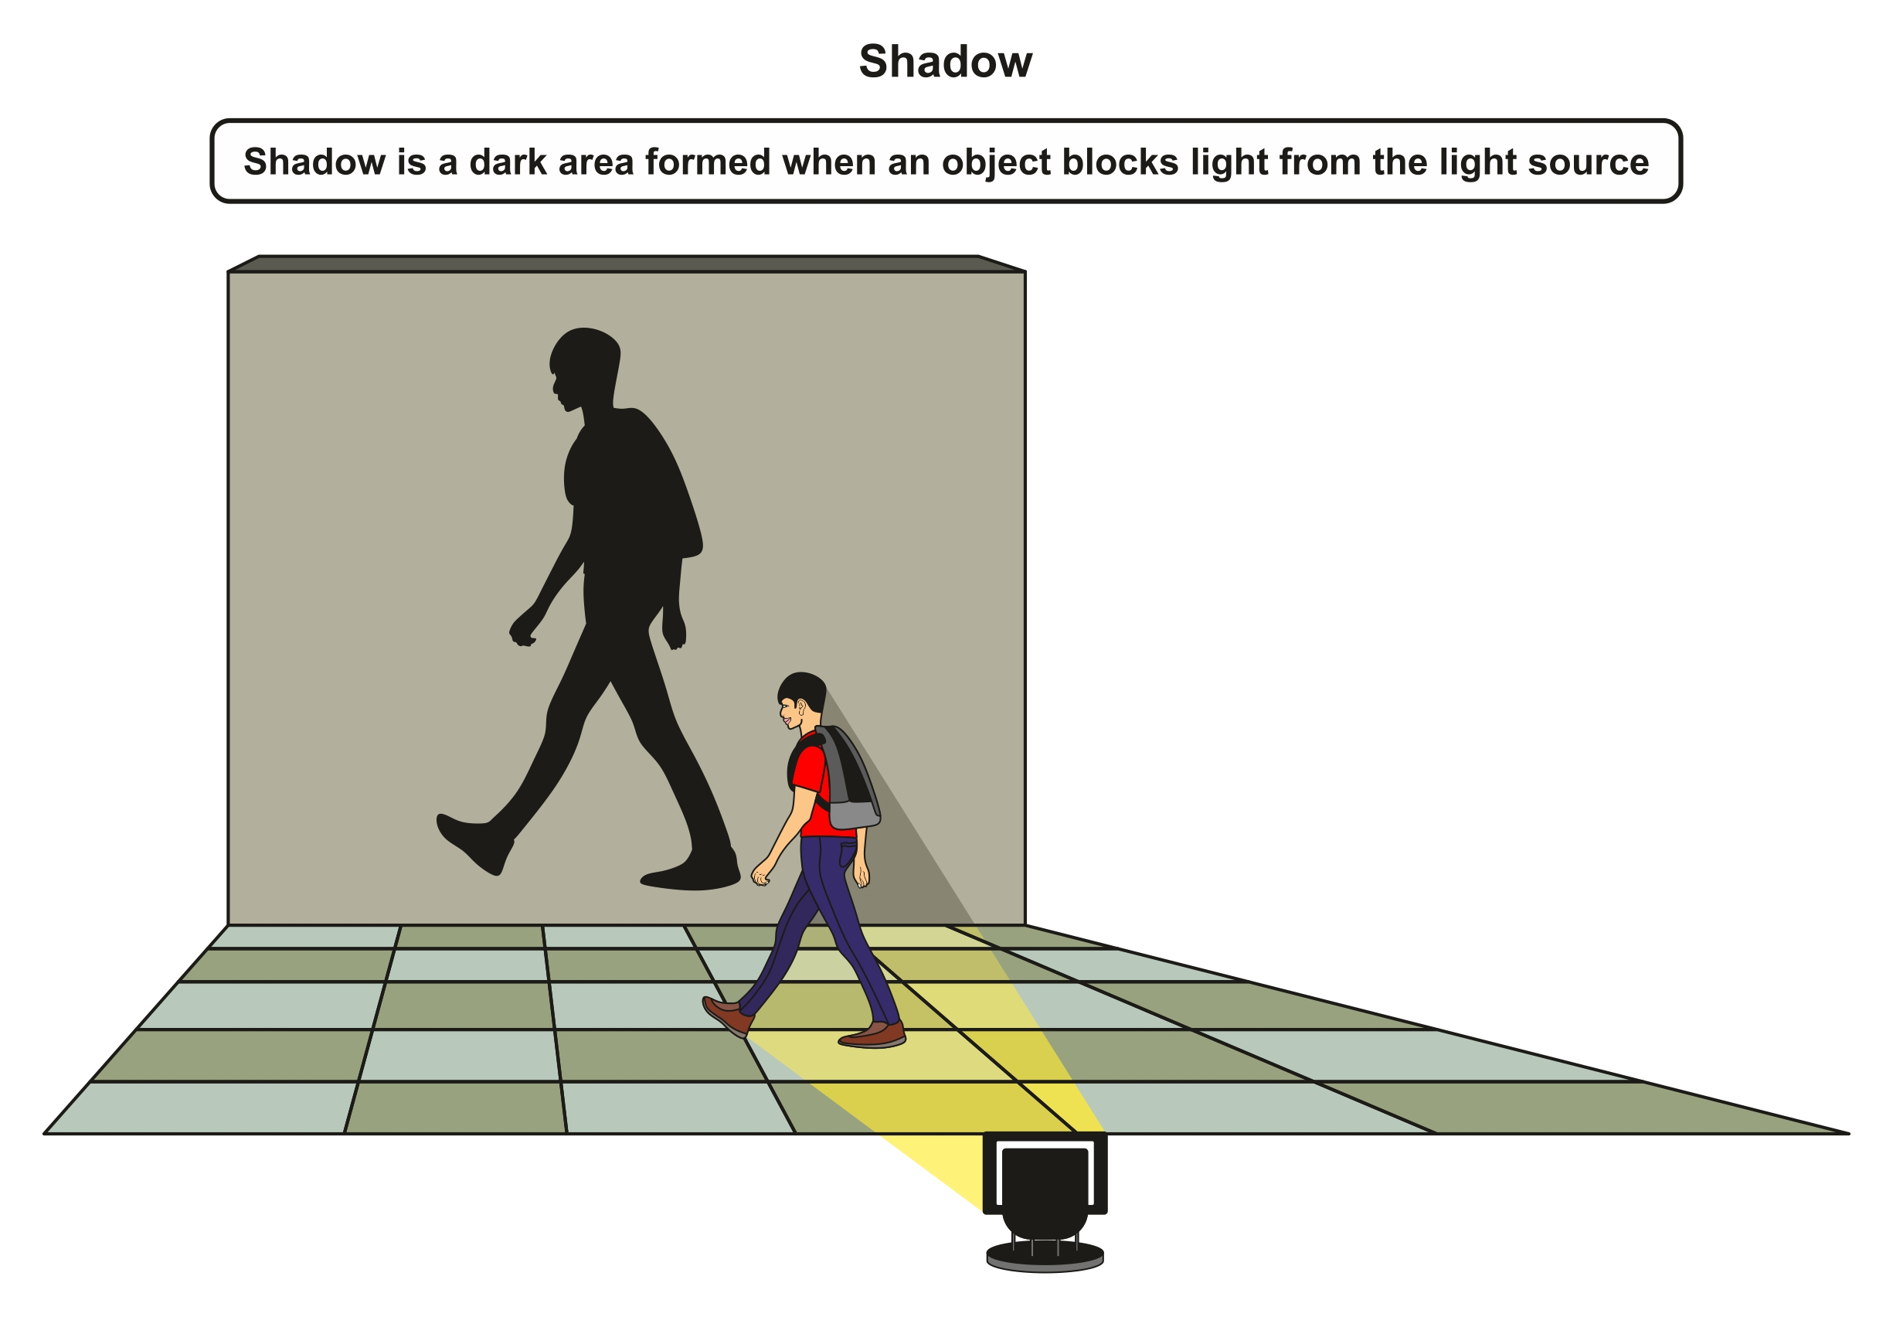
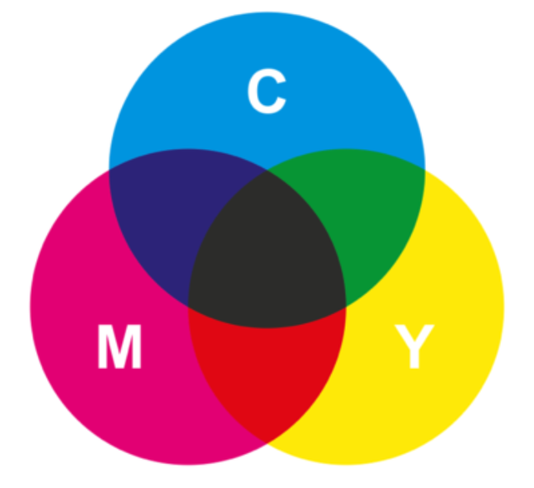


Knowledge Organiser Year 6
Unit: Light
Light sources can be both natural and man-made.
A lens is a piece of transparent glass or plastic that bends light.
Light only travels in
straight lines.
ROCKET WORDS Learn these words and their definitions.
Key Word | Definition
transparent | An object or material that allows light to pass through easily.
opaque | An object or material which doesn’t allow light through.
translucent | An object or material which allows some light to pass and scatters light rays.
magnify | To make an image larger.
angle of incidence | The angle made by a light ray as it strikes a mirror.
angle of reflection | The angle made by a light ray as it reflects off a mirror.
lens | A transparent material which changes the direction of movement of light.
refraction | The action of distorting an image by viewing through a medium.
Angles of Incidence and Reflection
FACTOIDS:
Can you find out more?
Q1. How does a lens work?
A1. They bend rays of light as they pass through so they can change path or direction.
Q2. What colours is light made up from?
Light is made up of all the colours of the spectrum / rainbow. The colour of the light you see depends on its wavelength.
Q3. How does a telescope work?
They have two lenses (one large and one small) which reflect light rather than bending it.
Lesson Sequence
1
Compare materials of different transparencies
2
Describe how lenses can be used
3
Explore water lenses
4
5
6
Describe the reflection of light
Investigate light colour mixing
Explain how shadows form
How a shadow forms
Unit: Light
This unit will help you understand how light travels, as well as exploring how the path and colour of light can change. A key focus is lenses, and how lenses in our eye, in cameras and in microscopes can change the way we view an object.
It is important to think about how lenses are used in scientific research and industry, which is why many of the activities in this unit will help you build your own lenses or observe objects through a lens. We take light for granted, but it is amazing how it travels, moves, reflects and changes.
Light filters can be used to mix or change the colour of the light.

