Slide 1
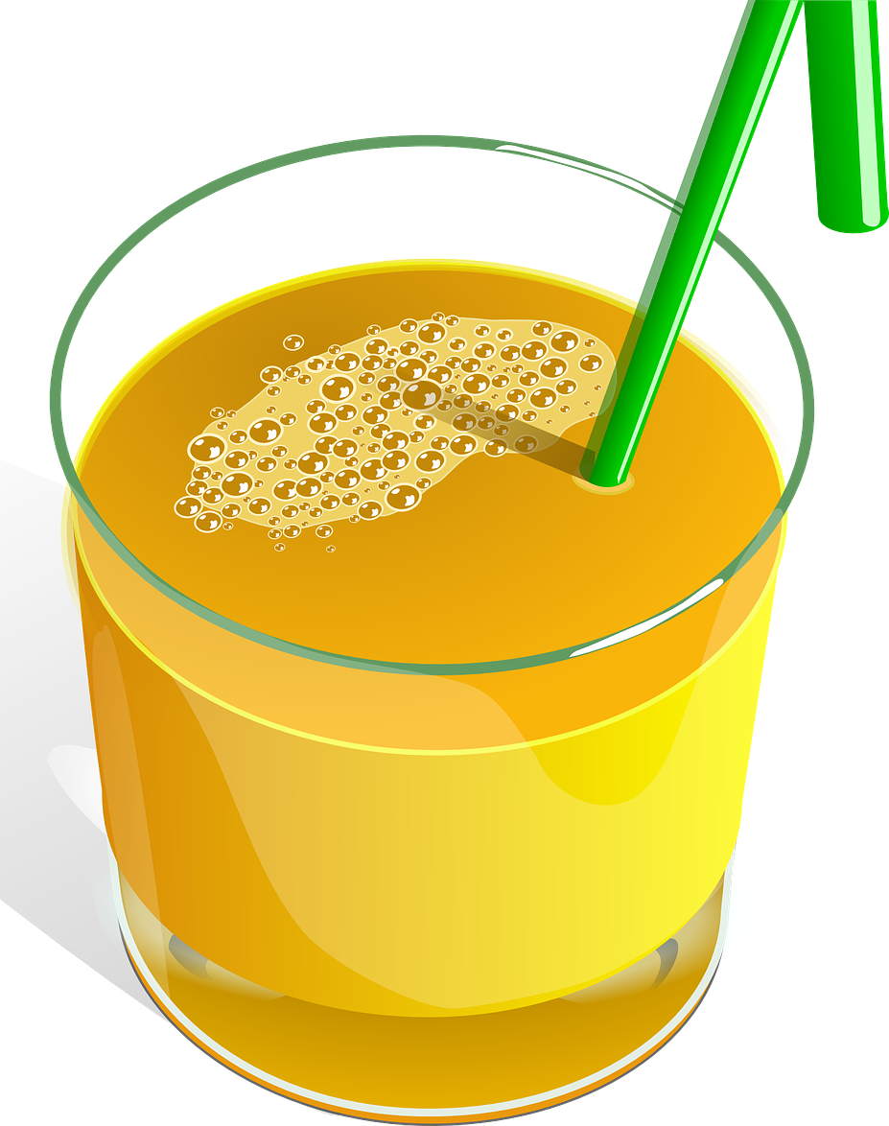
A ‘mixture’ is something that is physically joined together but can be separated again.
Knowledge Organiser
Unit: States of Matter
Mixtures can be separated in so many ways – such as evaporation, distillation, filtering and absorption.
ROCKET WORDS Learn these words and their definitions.
Key Word | Definition
water cycle | The processes that water takes between the earth’s oceans, land and atmosphere.
molecule | A group of atoms bonded together that can take part in a chemical reaction.
solute | Something which is dissolved in a solution.
solvent | The ability to dissolve other substances.
evaporation | The process of liquid turning to vapour.
water vapour | The form water takes when it evaporates into a gas in the air.
condensation | The conversion of a vapour or gas to a liquid, often collects as droplets on a cold surface.
distillation | The action of purifying a liquid by heating and cooling.
NIT LESSONS
The Water Cycle
1
2
Investigate the effect of temperature on drying washing
3
Understand dissolving and diluting
4
5
6
Understand evaporation and condensation
Understand the water cycle
Explore separating simple mixtures of substances
Understand that water exists in three different states of matter
condensation
(builds in clouds)
sun
(energy and heat)
precipitation
(rain, sleet, snow)
evaporation
(water vapour)
runoff & collection
Dissolving
The item being dissolved is the solute.
The substance dissolving it is called the solvent.
When the solvent can dissolve no more of the solute, it is called ‘saturation’
Diluting
This process reduces the concentration of a solute in a solution.
Takes place by adding more of the solvent to the solute.
A good example of this is adding more water to orange squash.
States of Matter

