Slide 1
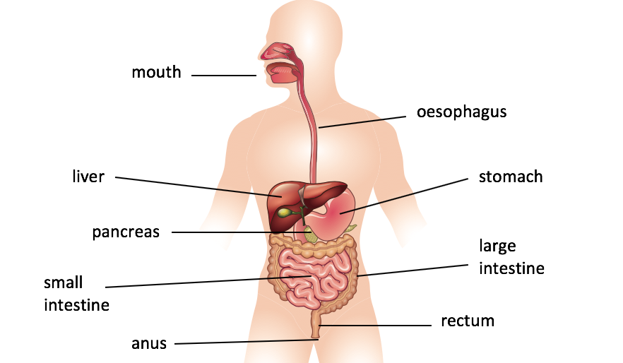

Our small intestine measures around 6 metres long if you stretched it out! Hardly ‘small’ is it?
Knowledge Organiser
Unit: Animals Including Humans – Food and digestion
The average adult human produces about
160kg of poo in a year!
ROCKET WORDS Learn these words and their definitions.
Key Word | Definition
salivary gland | A gland which produces saliva (spit) to help you digest your food.
oesophagus | A muscular tube connecting the throat and the stomach.
intestines | Including the large and small intestine, these are the tubes which pass your food from stomach to anus and help sort food and waste.
food pyramid | A graphic which outlines different food and healthy eating.
nutrient | A substance that offers nourishment to the body. We need these to be healthy.
vitamin | A group of compounds which are essential for healthy growth, they are found in food.
digest | To break down food within the body.
decomposer | An organism that breaks down organic material.
The digestive system
NIT LESSONS
1
2
Know the different types of teeth
3
Understand the intestines
4
5
6
Understand the food pyramid and why it’s important
Know about vitamins and minerals
Understand the food chain; know how natural cycles work
Understand salivary glands and taste buds
Fun Food Facts!
Most of our protein comes from meat, fish, eggs and nuts.
Fruit and vegetables are full of the vitamins we need to be healthy.
A food chain is vital for nature to survive
We are ‘consumers’ as we eat food to make the energy we need.
In the UK, 1.9 million tonnes of food is wasted each year!
The food
pyramid

