Slide 1
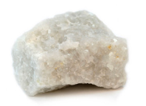
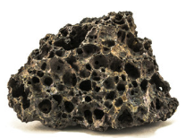
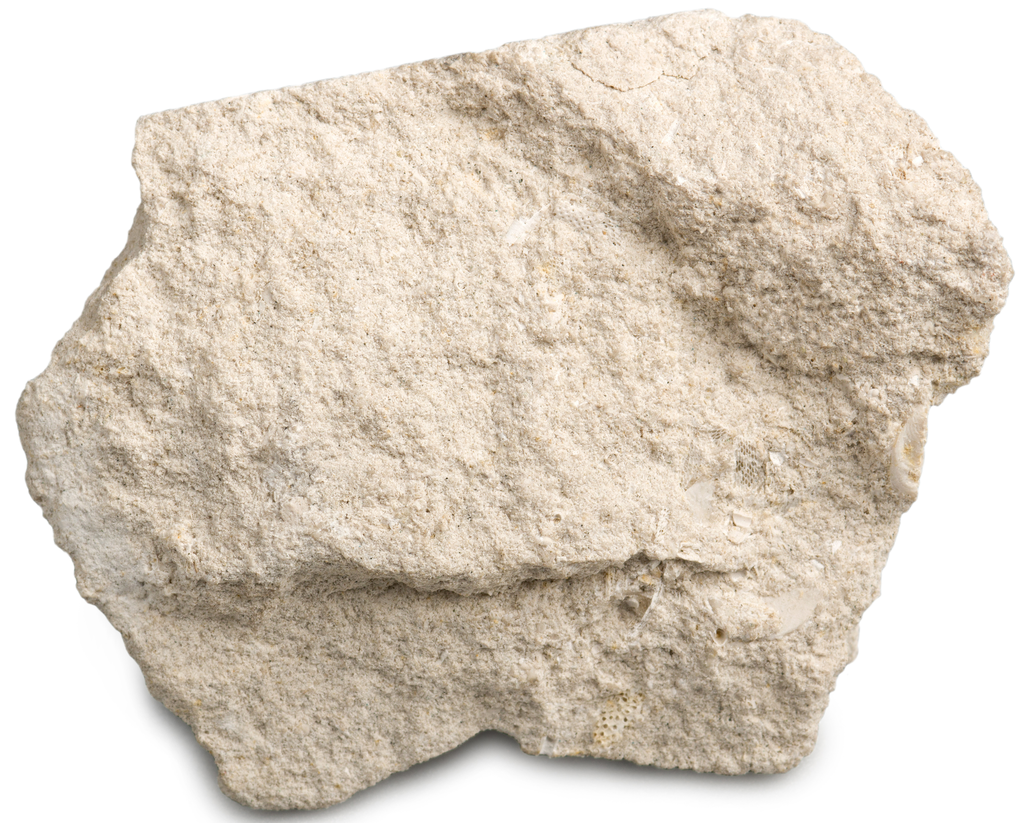
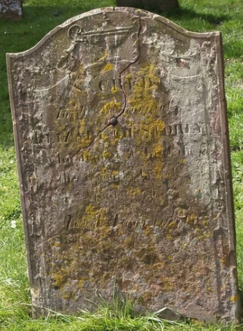
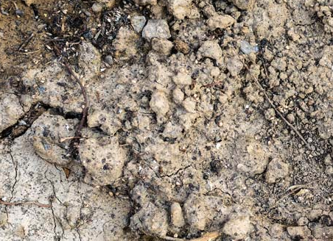
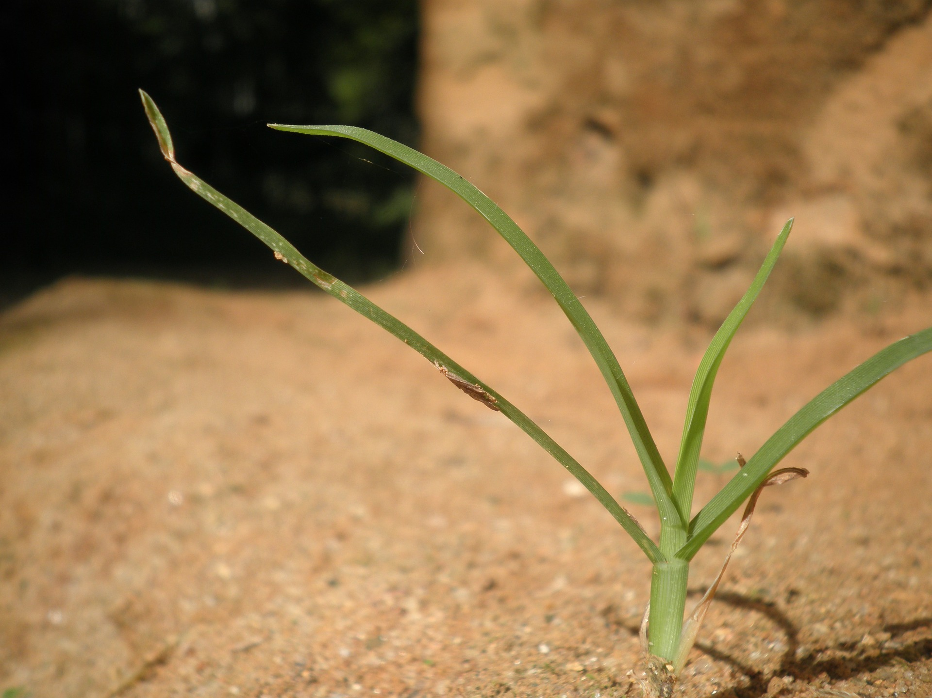
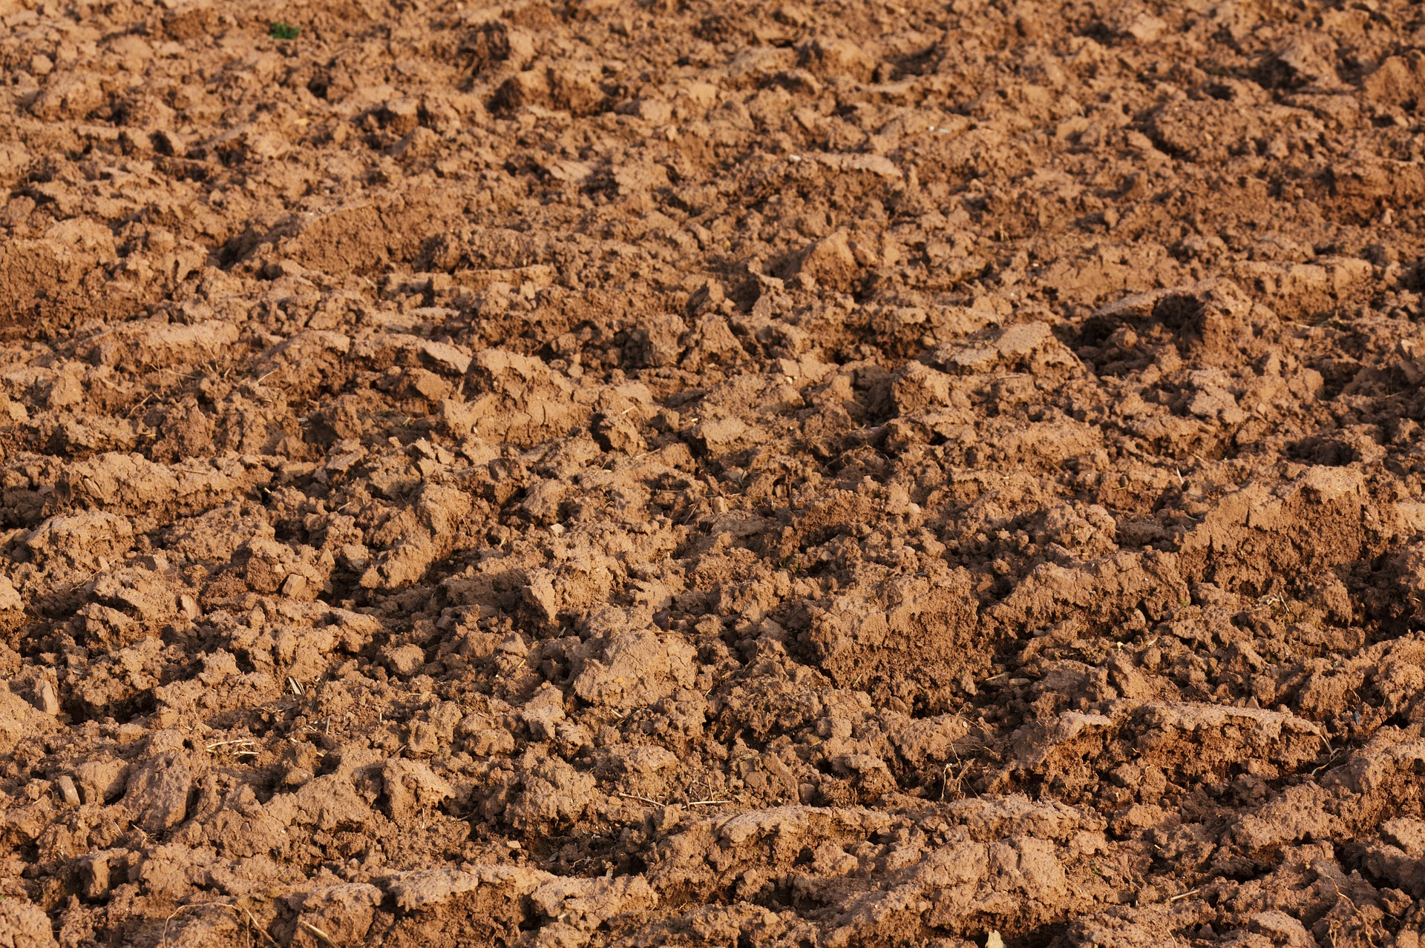
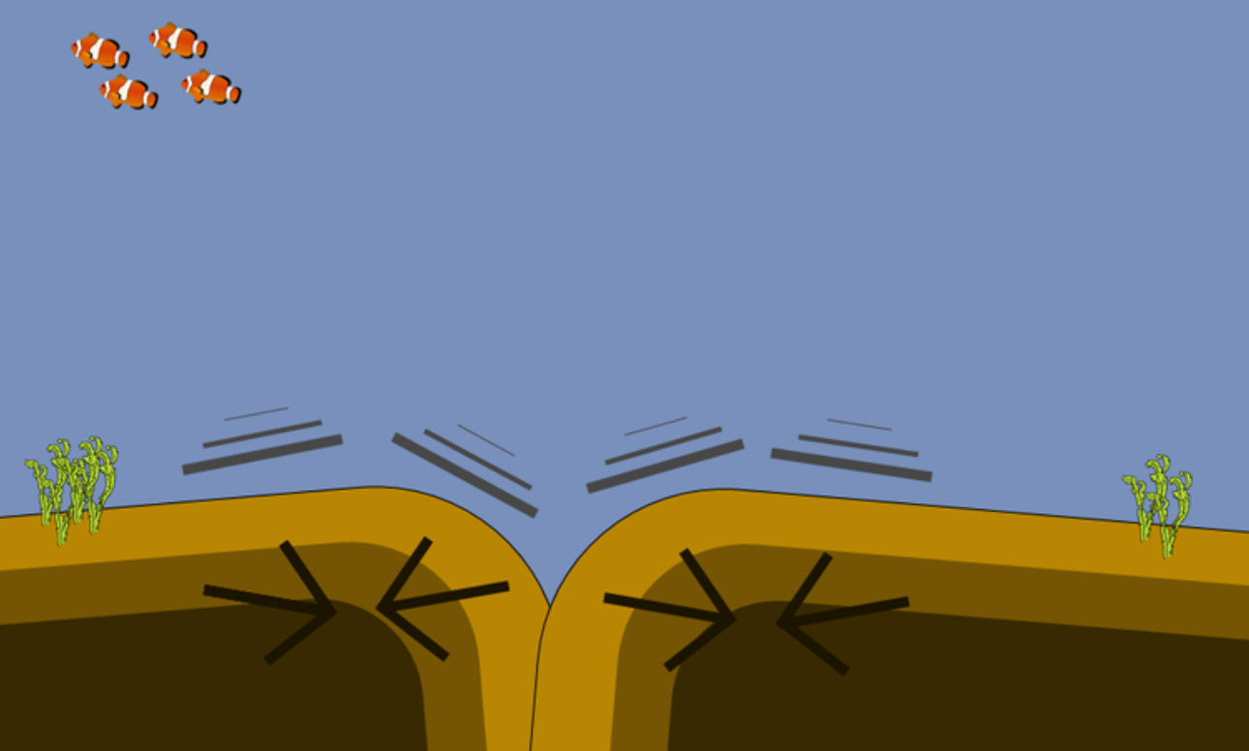
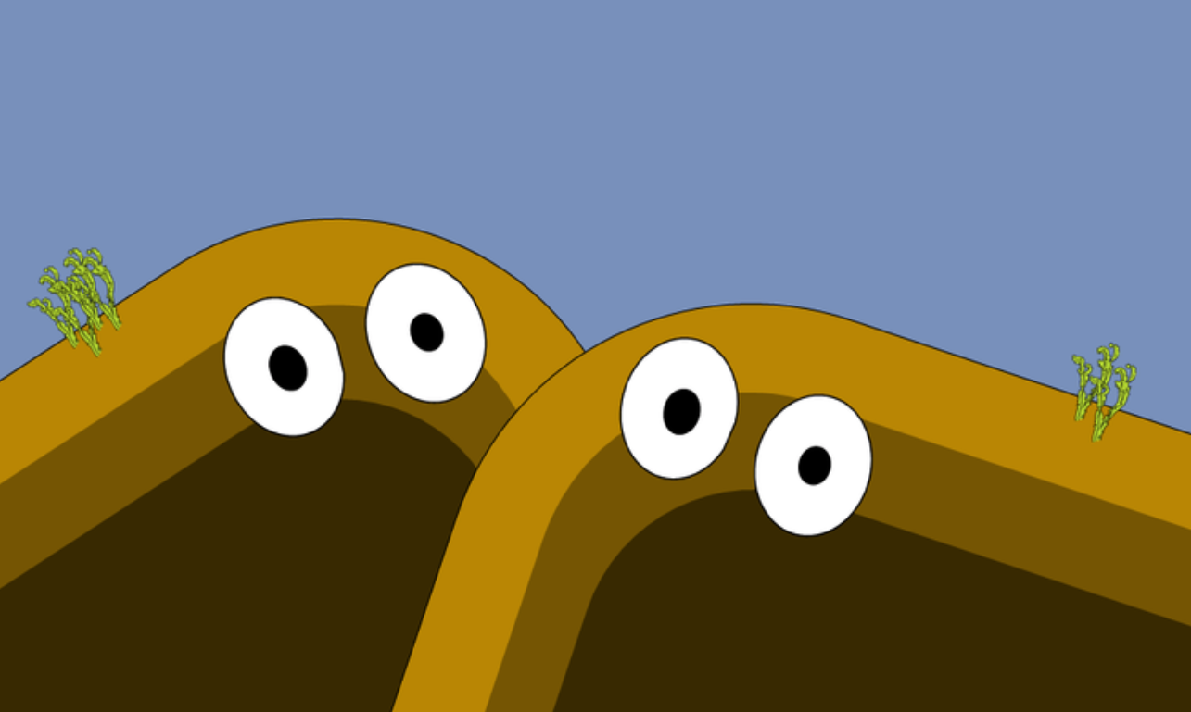


Knowledge Organiser
Rocks
ROCKET WORDS Learn these words and their definitions.
Key Word | Definition
metamorphic rock | A rock made by changing existing rocks by heat or pressure.
igneous rock | A rock made from solidified lava or magma.
sedimentary rock | Rock made when sand, mud and pebbles join in layers.
soil types | These include clay, chalky and sandy and depend on the feel and density of the soil.
weathering | When rocks get worn away and break due to physical, chemical or biological processes.
acid rain | Rain which becomes acidic due to pollution.
fossil | The remains of a prehistoric animal or plant embedded in a rock.
mineral | A solid substance naturally formed underground i.e. coal.
metamorphic
igneous
sedimentary
Weathering
A good way to discover different types of weathering is by a trip to a graveyard.
Rock & Soil Types
Chemical weathering can be caused by acid rain dissolving the rock over many years.
Physical weathering
is when rocks can be broken up by ice, which thaws in the rock and makes it crack.
chalky
sandy
peaty
Rock Type
Rocks react to weathering in different ways. The most common rocks for gravestone are marble, slate and granite.
Lesson sequence
Biological weathering
is when plants and fungi , such as lichens and moss grow on the gravestone.
1
2
Describe how mountains are formed
3
Learn about different types of rock
4
5
6
Understand what a fossil is
Describe what soils are made of
Classify different types of gravestone weathering
Observe rocks, including those used in buildings and gravestones
How mountains are formed.
The tectonic plates are constantly moving.
Sometimes they join together and hit one another.
They don’t break up, but instead push upwards in the water together.
They merge together underwater and eventually push above the water’s surface to form a big mountain.
Eventually, a huge ‘fold’ mountain is formed. This is how the world’s tallest mountain, ‘Everest’ was made.

